Slide 1

SonicSafe THE ANIMAL REPELLENT DEVICE
Presentation By
Annet Janishma Lewis MCA ‘A’
Reg no. 24250112

Slide 2
Index
Introduction
Execution Summary
Lean canvas
Company Description
Business Model
Market Analysis
Operational Plan
Financial Summary
Conclusion

Slide 3
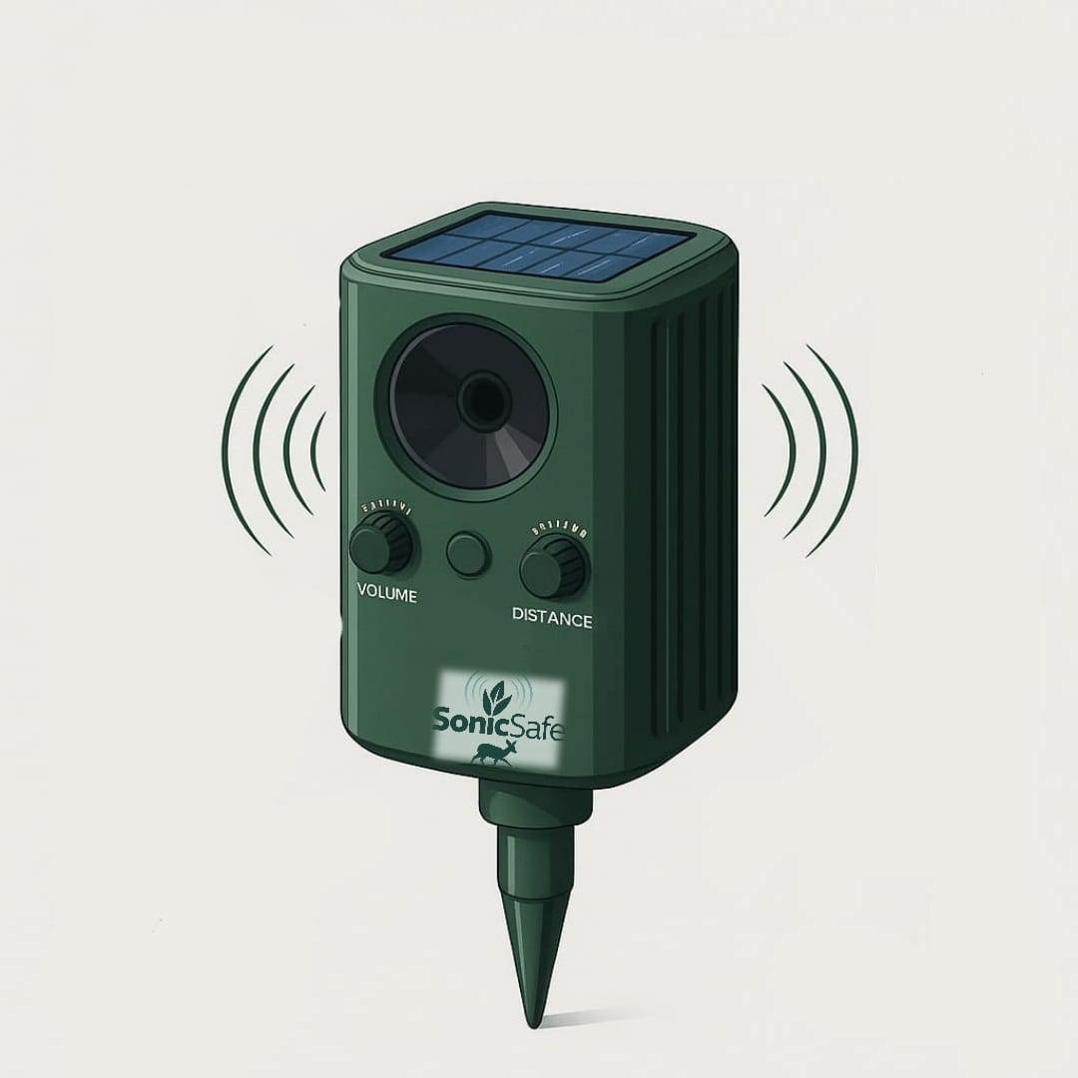
Introducing SonicSafe
SonicSafe is an advanced, solar and USB-powered ultrasonic animal repellent. It protects outdoor spaces by deterring stray animals and birds without causing distress.

Slide 4





Addressing Key Problems
Animal Intrusion
Mitigating damage to farms and properties.
Crop & Property Damage
Reducing financial losses from animal activity.
Lack of Humane Deterrents
Providing ethical and legal solutions.
High Cost & Maintenance
Offering an affordable, low-upkeep alternative.

Slide 5

The Innovative Solution
Dual Power
Solar-powered with optional USB Charging
Ultrasonic Sound
Emits high frequency sound waves up to 20KHz
Wide Coverage
Covers 30 cents per device for broad protection
Eco-friendly
Chemical free, non-lethal, humane
Adjustable Volume
Control sound intensity based on need and environment
Weather Resistant
Built to withstand outdoor conditions
Portable Design
Lightweight and easy to move or install

Slide 6
Execution Summary
Sonic safe is a solar and USB-powered ultrasonic animal repellent designed to protect outdoor spaces using high-frequency sound and motion sensors. It safely deters animals like monkeys, dogs, wild boars, and birds without harming them. Ideal for farmers, gardeners, homeowners, factories, and outdoor dining spaces, it’s eco-friendly, non-lethal, weather-resistant, and easy to use.
vision is to lead in humane, sustainable outdoor protection. mission is to deliver a simple, safe, and eco-friendly solution for keeping
animals away without harm.

Slide 7
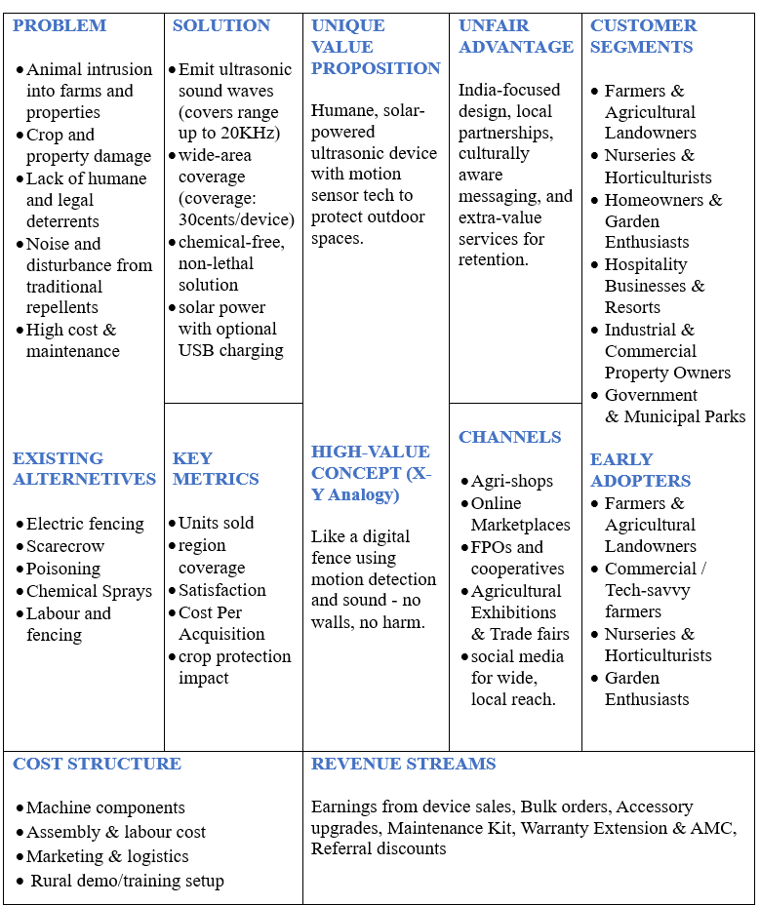
LEAN CANVAS

Slide 8

COMPANY DESCRIPTION
Business Name: Sonic Safe
Logo:
Business Type: Private Startup
Business Structure: Partnership or Private Limited Company (recommended for growth,
liability protection, and technology investment)
Stage: Early-stage, pre-revenue startup
Founded: 2025
Long term Vision : To become most trusted name in humane animal intrusion control across India.

Slide 9
Business Model
Distribution & Sales
Product Offering
Pricing (INR)
Direct sales at exhibitions, agri-fairs, gardening outlets
Solar + USB powered ultrasonic animal repellent with motion sensor.
Single Unit: ₹2,800
Commission-based local agents and field representatives
Single-unit pack: For small areas
Combo Pack (3 Units): ₹7,560
(10% discount)
Target Customers
Triple-unit combo pack: For large coverage
Optional add-ons: Mounting accessories
Small to medium-scale farmers
Gardeners and nursery owners
Factory, warehouse, restaurant, hotel owners
Promotion
Sales Force
Revenue Model
Training & Support
Local ads: agri-shops, co-ops
Trained field sales team/commissioned agents
Sales partners/agents earn commission per unit
Sales reps: simple training manual, demo kit
Village-level agri-events
Social media reels in regional languages
Collaboration: agri extension workers, NGOs
Example: ₹150–₹250 per unit
Customers: user manual, basic troubleshooting guide
Retail tie-ups: fertilizer, gardening stores
Retailers/local shopkeepers as partners

Slide 10



Market Analysis
Farmers & Landowners
Nurseries & Horticulture
Prevent crop damage from various pests.
Prevent high value plants
Homeowners & Gardeners
Government & Municipal parks
Protect gardens from stray animals and birds.
Deter Animals from public space.
Hospitality & Resorts
Maintain clean, animal-free outdoor environments.
Industrial Properties
Prevent property damage.

Slide 11
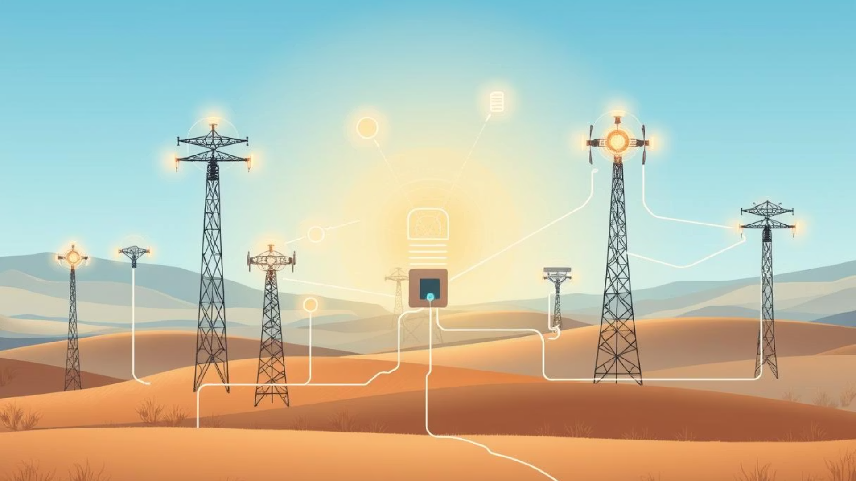
Operational Plan
Production
Quality Control
Safety & Environment
Component checks
Component testing
Eco-friendly materials
Device assembly
Detection checks
Non-target species protection
Weatherproofing inspection
Issue logging
Daily Operations
Maintenance
Logistics
Monitor power/sensors
Monthly inspections
Inventory tracking
Collect activity data
Battery/solar replacement
Transport planning
Perform maintenance
Sensor calibration
Device location/status logging
Update firmware
Parts repair

Slide 12
Financial Overview
Statement (for 100 Units)
3-in-1 Package Summary
Hardware | 1,55,00
Assembly & Labor | 30,000
Marketing & logistic | 13,000
Total cost | 1,98,000
Cost Price (3 units) | 5,940
Selling Price | 8,400
10% Deduction | 840
Net Payable | 7,560
Profit (per package) | 1,620
Selling price | 2,80,000
Gross profit | 82,000
Selling price for 1 unit | 2,80,000
Profit per unit | 820
Profit Milestone Analysis
Units Sold | Revenue (INR) | Cost (INR) | Profit (INR)
100 Units | 2,80,000 | 1,98,000 | 82,000
200 Units | 5,60,000 | 3,96,000 | 1,64,000
500 Units | 14,00,000 | 9,90,000 | 4,10,000

Slide 13
Long term Income Opportunity
Service | Estimated charge per Unit | Potential Profit per 100 Units
Chargeable Battery Replacement(LiFePO4 / Lead acid) | 700 | 25000
Upgrade Module sale | 1000 | 40,000
Maintenance Kit | 700 | 28,000
Warranty Extension | 600 | 20,000
Referral Discounts | -200 | -10,000
Total Estimated Profit |  | 103000

Slide 14
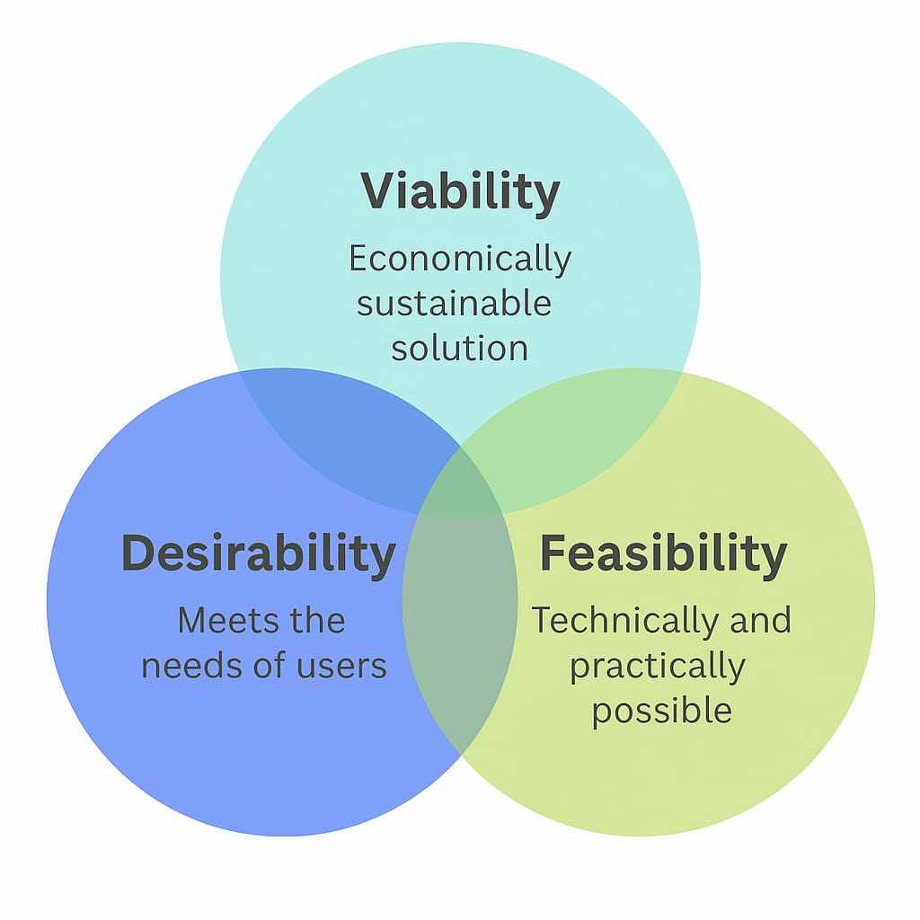
SonicSafe-Product Strengths
Viability: Sonic Safe offers a scalable business model with affordable production, strong rural/urban demand.
Durability : The product is built with weather-resistant materials, ensuring long-lasting performance in outdoor environments.
Feasibility: Its solar and USB-powered design makes it highly adaptable and easy to implement across varied rural and urban setups.

Slide 15

Conclusion: A Sustainable Future
SonicSafe offers a humane, eco-friendly solution to animal intrusion. Its solar and USB power, durability, and ease of use make it versatile. This device supports sustainable living and responsible land use.

Slide 16
THANK YOU

